Slide 1

BANK CUSTOMER SEGMENTATION
PRESENTED BY:
MANNE AKSHITHA
MAMIDI HEMA GOUD
BATCH NO:456

Slide 2
Agenda
➤ Introduction
➤ Business Problem
➤ Business Objective
➤ Insights
➤ Customer Demographics Analysis
➤ Transaction Behavior Insights
➤ Customer Segmentation Analysis
➤ Profitability Risk & Indicators
➤ Conclusion
➤ Recommendations

Slide 3
Introduction
Banks have a large number of customers with different needs and behaviors.
Understanding customer behavior is important to improve services, customer satisfaction, and business growth.
This project analyzes bank customer transaction data to understand how customers behave differently.
The analysis helps the bank to identify valuable customers, reduce customer loss, and make better business decisions.

Slide 4
Business Problem
Banks cannot quickly identify customers who are becoming inactive.
Loyal customers are treated the same as low-value customers.
Marketing offers are sent to the wrong customers, reducing effectiveness.
Banks face difficulty in predicting customer churn in advance.
Customer service teams lack insights into customer behavior history.
Revenue opportunities are lost due to poor personalization.
Manual analysis is time-consuming and not suitable for real-time decisions

Slide 5
BUSINESS OBJECTIVE
The main business objective of this project is to analyze bank customer and transaction data to understand customer behavior and identify patterns that support better decision-making. By segmenting customers into new, loyal, and lost groups and applying RFM analysis, the project aims to identify high-value customers and customers at risk of churn. The analysis also focuses on assessing customer risk using credit scores and understanding profitability across different customer segments.

Slide 6
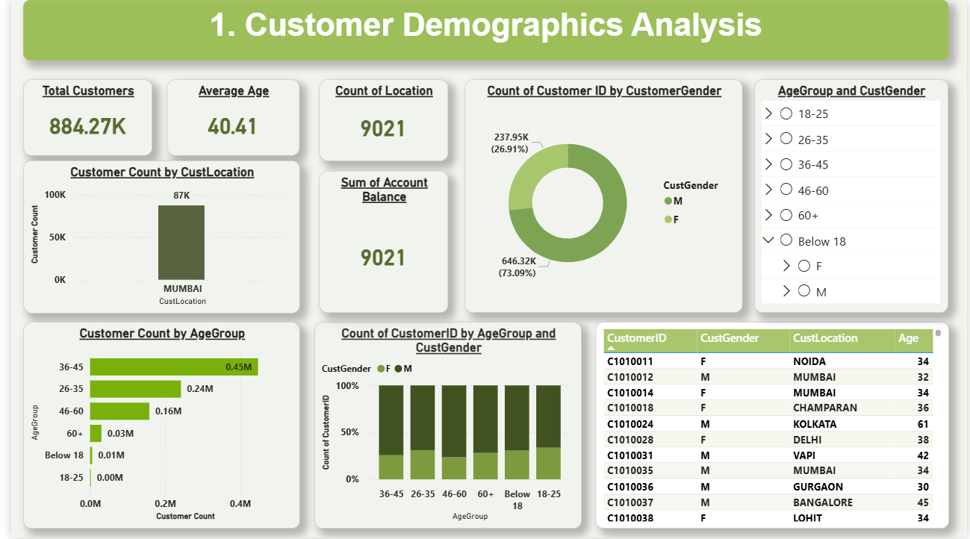

Slide 7
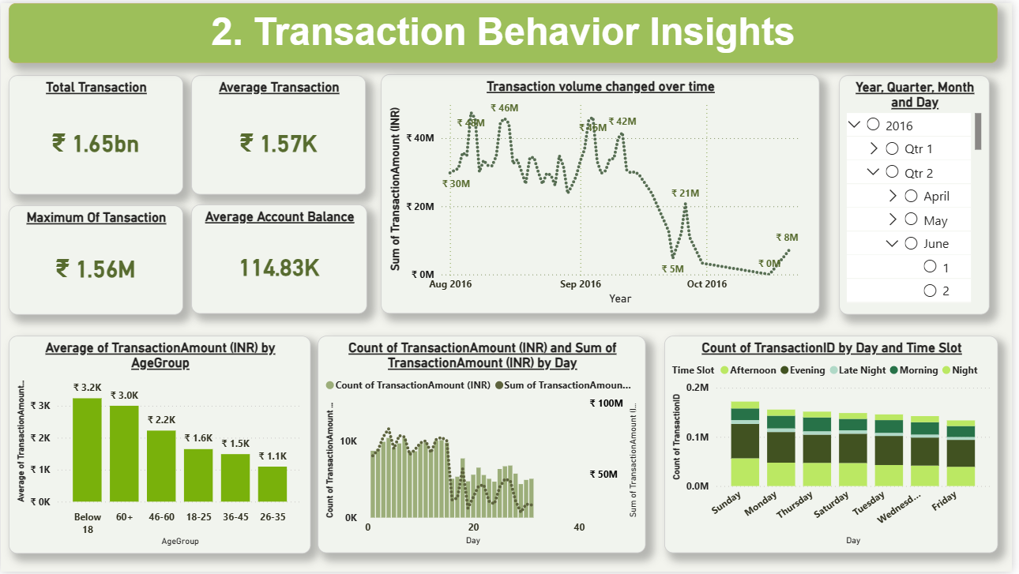

Slide 8
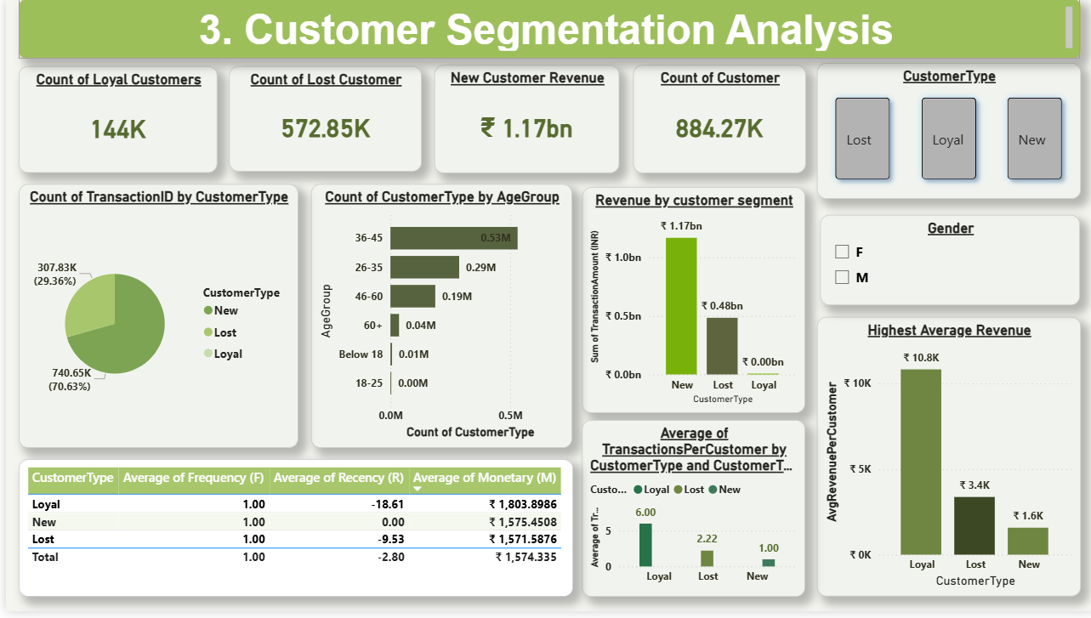

Slide 9
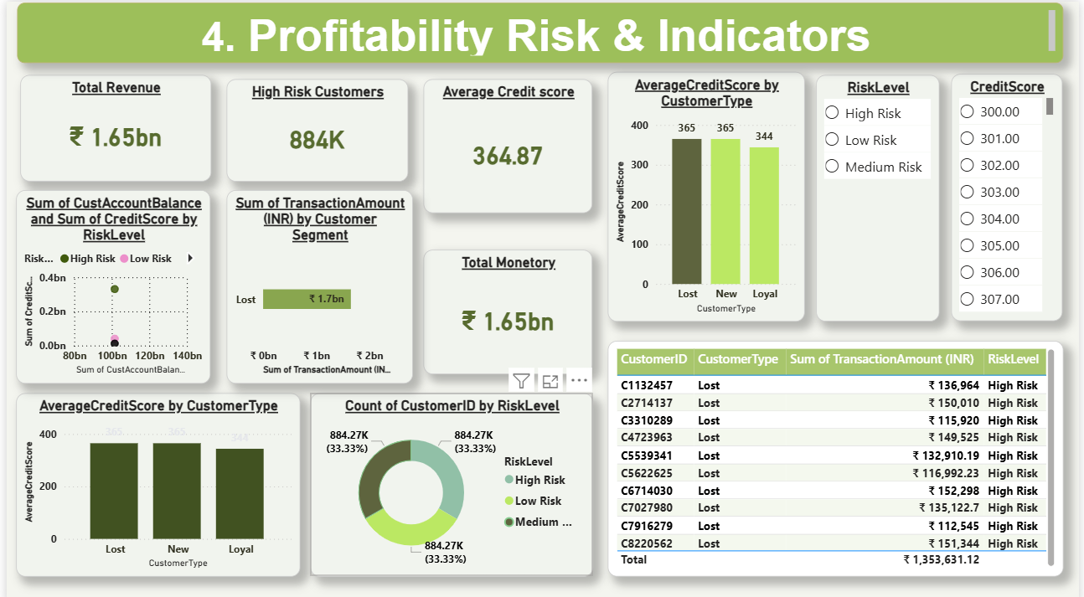

Slide 10
INSIGHTS
Loyal customers generate maximum value
Early churn signals can be detected using transaction patterns
Marketing efforts are not optimally targeted
Marketing efforts are not optimally targeted
High-risk customers do not always generate high revenue
Lack of personalization leads to revenue loss
Manual analysis limits timely decision-making

Slide 11
Conclusion
This project helps banks understand real-time customer behavior using transaction data. By segmenting customers, banks can quickly identify active, inactive, and high-value customers and take timely actions such as personalized offers and retention strategies. Overall, the dashboard supports faster decision-making and improves customer engagement and revenue in real-time banking operations.

Slide 12
Recommendations
Based on this customer segmentation project, banks should use transaction data regularly to monitor customer activity and segment customers into new, loyal, and inactive groups. By doing this, banks can focus more on high-value customers, re-engage inactive customers with targeted offers, and guide new customers toward long-term relationships. The dashboard can be used in real time to track customer behavior, support quick decisions, and improve customer retention and revenue growth.

Slide 13

THANK YOU

